Slide 1
Programming Massively Parallel Processors Using CUDA
Introduction
(Chapters 1-2 in Text)

Slide 2


Acknowledgements
Professors and Authors of CUDA textbook
Wen-mei Hwu
Endowed Chair Professor of ECE at Univ. of Illinois
David Kirk
Chief Scientist, NVIDIA and Professor of ECE
Slides with copyright notice below are due to Profs Wen-mei Hwu and David Kirk or else are minor modifications of their slides.
Mary Hall, CS4961, Univ of Utah, Slides used as reference and may be used in modified form in class presentations.
Dan Ernest and Brandon Holt, Univ of Wisconsin at Eau Claire, Their slides were used in educational program at SC11 and will be used for reference and possibly for slides

Slide 3
Web Resources
Web site: http://courses.ece.uiuc.edu/ece498/al
Handouts and lecture slides/recordings
Textbook in Draft format: Programming Massively Parallel Processors: A Hands-on Approach, 2010, Morgan Kaufmann (Elsevier Inc.)
Documentation and software resources
Others will be added

Slide 4
Text/Notes
Draft textbook by Prof. Hwu and Prof. Kirk available at the website
NVIDIA, NVidia CUDA Programming Guide, NVidia, 2007 (reference book)
T. Mattson, et al “Patterns for Parallel Programming,” Addison Wesley, 2005 (recomm.)
Lecture notes and recordings are already posted at the web site: http://courses.ece.uiuc.edu/ece498/al

Slide 5
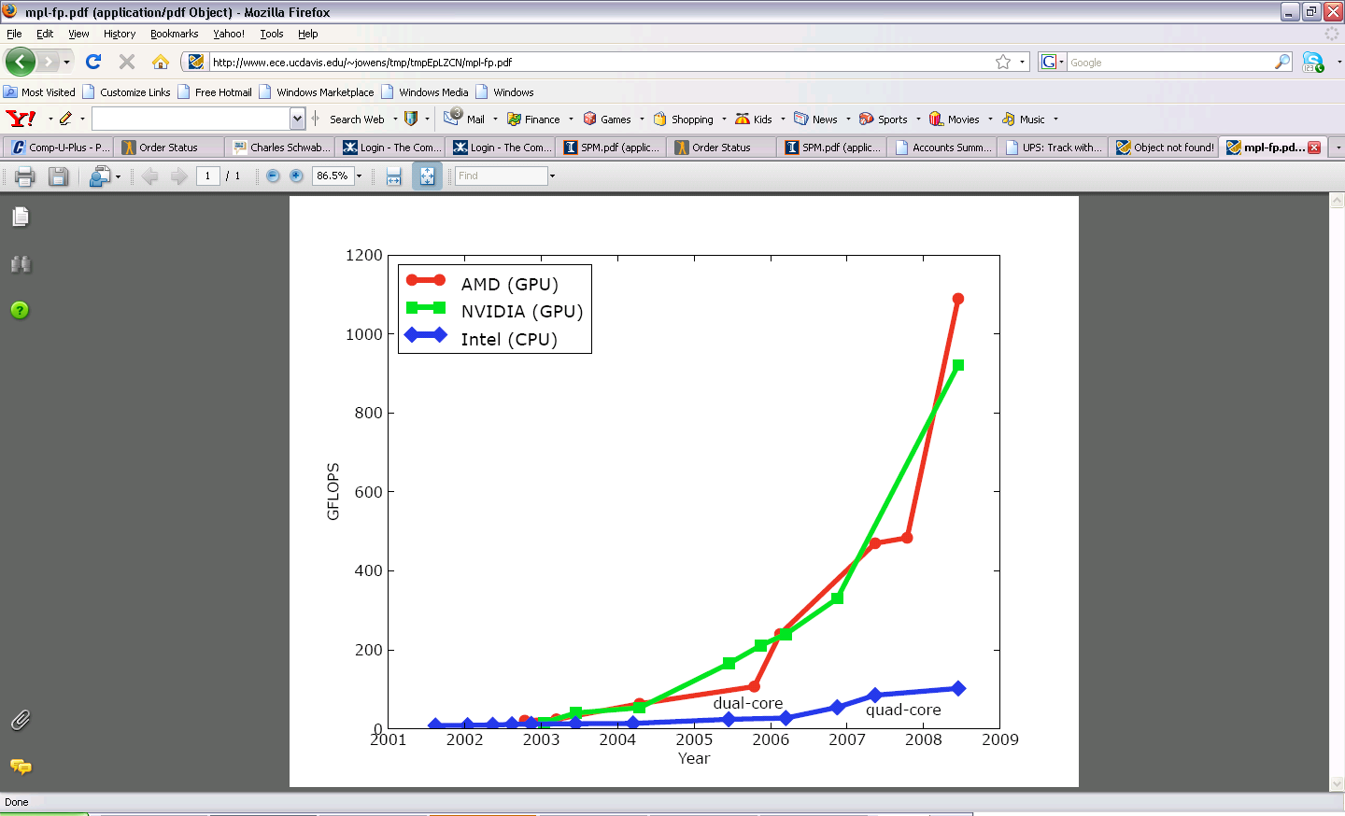
Why Massively Parallel Processor
A quiet revolution and potential build-up
Calculation: 367 GFLOPS vs. 32 GFLOPS
Memory Bandwidth: 86.4 GB/s vs. 8.4 GB/s
Until last year, programmed through graphics API
GPU in every PC and workstation – massive volume and potential impact

Slide 6
CPUs and GPUs have fundamentally different design philosophies
Control
ALU
ALU
ALU
ALU
CPU
GPU
Cache
DRAM
DRAM

Slide 7
Architecture of a CUDA-capable GPU
Host
Input Assembler
Thread Execution Manager
Parallel Data Cache
Parallel Data Cache
Parallel Data Cache
Parallel Data Cache
Parallel Data Cache
Parallel Data Cache
Parallel Data Cache
Parallel Data Cache
Texture
Texture
Texture
Texture
Texture
Texture
Texture
Texture
Texture
Load/store
Load/store
Load/store
Load/store
Load/store
Load/store
Global Memory

Slide 8
GT200 Characteristics
1 TFLOPS peak performance (25-50 times of current high-end microprocessors)
265 GFLOPS sustained for apps such as VMD
Massively parallel, 128 cores, 90W
Massively threaded, sustains 1000s of threads per app
30-100 times speedup over high-end microprocessors on scientific and media applications: medical imaging, molecular dynamics
“I think they're right on the money, but the huge performance differential (currently 3 GPUs ~= 300 SGI Altix Itanium2s) will invite close scrutiny so I have to be careful what I say publically until I triple check those numbers.”
-John Stone, VMD group, Physics UIUC

Slide 9
Future Apps Reflect a Concurrent World
Exciting applications in future mass computing market have been traditionally considered “supercomputing applications”
Molecular dynamics simulation, Video and audio coding and manipulation, 3D imaging and visualization, Consumer game physics, and virtual reality products
These “Super-apps” represent and model physical, concurrent world
Various granularities of parallelism exist, but…
programming model must not hinder parallel implementation
data delivery needs careful management
Notes:
Do not go over all of the different applications. Let them read them instead.

Slide 10

Stretching Traditional Architectures
Traditional parallel architectures cover some super-applications
DSP, GPU, network apps, Scientific
The game is to grow mainstream architectures “out” or domain-specific architectures “in”
CUDA is latter
Notes:
This leads to memory wall: Why we can’t transparently extend out the current model to the future application space: memory wall. How does the meaning of the memory wall change as we transition into architectures that target the super-application space.
Lessons learned from Itanium

Slide 11
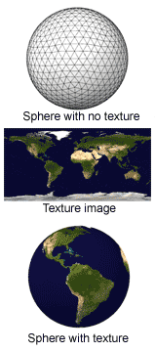
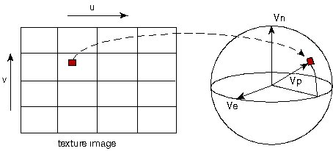
Texture Mapping Example
Texture mapping example: painting a world map texture image onto a globe object.

Slide 12
Speedup of Applications
GeForce 8800 GTX vs. 2.2GHz Opteron 248
10× speedup in a kernel is typical, as long as the kernel can occupy enough parallel threads
25× to 400× speedup if the function’s data requirements and control flow suit the GPU and the application is optimized
“Need for Speed” Seminar Series organized by Patel and Hwu this semester.
Notes:
All kernels have large numbers of simultaneously executing threads (ask me if you want to see details).
Most of the 10X kernels saturate memory bandwidth

Slide 13
Programming Massively Parallel Processors Lecture Slides for Chapter 2: GPU Computing History

Slide 14
A Fixed Function GPU Pipeline
Host
CPU
Host Interface
GPU
Vertex Control
Vertex
Cache
VS/T&L
Triangle Setup
Raster
Frame
Buffer
Memory
Texture
Cache
Shader
ROP
FBI

Slide 15
Texture Mapping Example
Texture mapping example: painting a world map texture image onto a globe object.

Slide 16
Anti-Aliasing Example
Triangle Geometry
Aliased
Anti-Aliased

Slide 17
Programmable Vertex and Pixel Processors
3D Application or Game
3D API Commands
CPU
3D API: OpenGL or Direct3D
CPU – GPU Boundary
GPU Command & Data Stream
Assembled Polygons, Lines, and Points
GPU
Pixel Location Stream
Vertex Index Stream
Pixel Updates
GPU Front End
Primitive Assembly
Rasterization & Interpolation
Raster Operations
Framebuffer
Pre-transformed Vertices
Transformed Vertices
Rasterized Pre-transformed Fragments
Transformed Fragments
Programmable Vertex Processor
Programmable Fragment Processor
An example of separate vertex processor and fragment processor in a programmable graphics pipeline

Slide 18
Unified Graphics Pipeline
Host
Data Assembler
Setup / Rstr / ZCull
Vtx Thread Issue
Geom Thread Issue
Pixel Thread Issue
SP
SP
SP
SP
SP
SP
SP
SP
SP
SP
SP
SP
SP
SP
SP
SP
Thread Processor
TF
L1
TF
L1
TF
L1
TF
L1
TF
L1
TF
L1
TF
L1
TF
L1
L2
L2
L2
L2
L2
L2
FB
FB
FB
FB
FB
FB

Slide 19
per thread
per Shader
per Context
Input Registers
Fragment Program
Texture
Constants
Temp Registers
Output Registers
FB Memory
The restricted input and output capabilities of a shader programming model.

Slide 20
Programming Massively Parallel Processors Lecture Slides for Chapter 3: CUDA Programming Model

Slide 21

What is (Historical) GPGPU ?
General Purpose computation using GPU and graphics API in applications other than 3D graphics
GPU accelerates critical path of application
Data parallel algorithms leverage GPU attributes
Large data arrays, streaming throughput
Fine-grain SIMD parallelism
Low-latency floating point (FP) computation
Applications – see //GPGPU.org
Game effects (FX) physics, image processing
Physical modeling, computational engineering, matrix algebra, convolution, correlation, sorting
Notes:
Mark Harris, of Nvidia, runs the gpgpu.org website

Slide 22
Previous GPGPU Constraints
Dealing with graphics API
Working with the corner cases of the graphics API
Addressing modes
Limited texture size/dimension
Shader capabilities
Limited outputs
Instruction sets
Lack of Integer & bit ops
Communication limited
Between pixels
Scatter a[i] = p
per thread
per Shader
per Context
Input Registers
Fragment Program
Texture
Constants
Temp Registers
Output Registers
FB Memory

Slide 23

CUDA
“Compute Unified Device Architecture”
General purpose programming model
User kicks off batches of threads on the GPU
GPU = dedicated super-threaded, massively data parallel co-processor
Targeted software stack
Compute oriented drivers, language, and tools
Driver for loading computation programs into GPU
Standalone Driver - Optimized for computation
Interface designed for compute – graphics-free API
Data sharing with OpenGL buffer objects
Guaranteed maximum download & readback speeds
Explicit GPU memory management

Slide 24
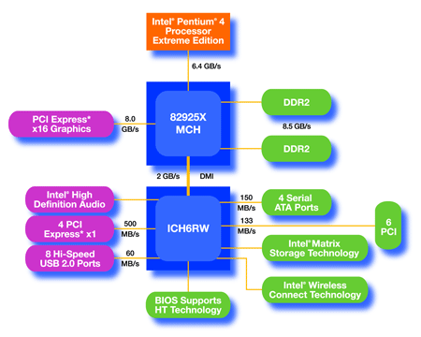
An Example of Physical Reality Behind CUDA
CPU
(host)
GPU w/
local DRAM
(device)

Slide 25
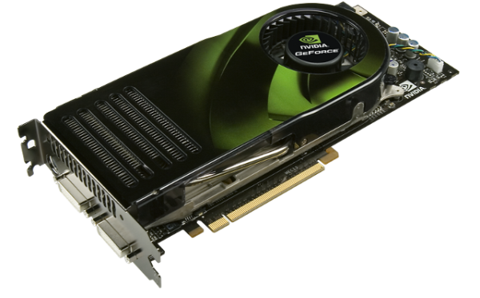
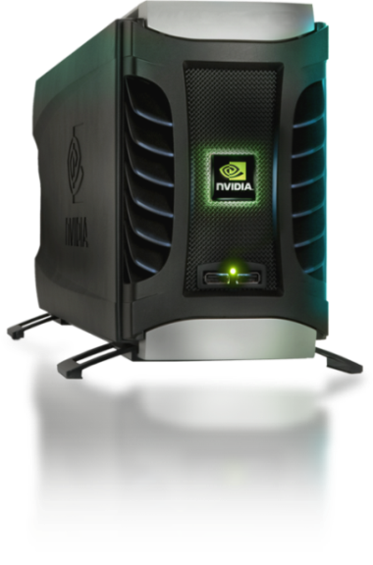
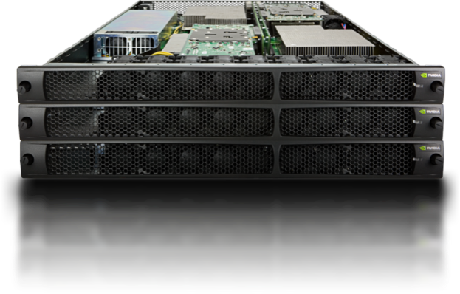
Parallel Computing on a GPU
8-series GPUs deliver 25 to 200+ GFLOPS on compiled parallel C applications
Available in laptops, desktops, and clusters
GPU parallelism is doubling every year
Programming model scales transparently
Programmable in C with CUDA tools
Multithreaded SPMD model uses application data parallelism and thread parallelism
GeForce 8800
Tesla D870
Tesla S870

Slide 26
Overview
CUDA programming model – basic concepts and data types
CUDA application programming interface - basic
Simple examples to illustrate basic concepts and functionalities
Performance features will be covered later

Slide 27
CUDA – C with no shader limitations!
Integrated host+device app C program
Serial or modestly parallel parts in host C code
Highly parallel parts in device SPMD kernel C code
Serial Code (host)‏
Parallel Kernel (device)‏
KernelA<<< nBlk, nTid >>>(args);
. . .
Serial Code (host)‏
Parallel Kernel (device)‏
KernelB<<< nBlk, nTid >>>(args);
. . .

Slide 28
CUDA Devices and Threads
A compute device
Is a coprocessor to the CPU or host
Has its own DRAM (device memory)‏
Runs many threads in parallel
Is typically a GPU but can also be another type of parallel processing device
Data-parallel portions of an application are expressed as device kernels which run on many threads
Differences between GPU and CPU threads
GPU threads are extremely lightweight
Very little creation overhead
GPU needs 1000s of threads for full efficiency
Multi-core CPU needs only a few

Slide 29
G80 – Graphics Mode
The future of GPUs is programmable processing
So – build the architecture around the processor
Host
Input Assembler
Setup / Rstr / ZCull
Vtx Thread Issue
Geom Thread Issue
Pixel Thread Issue
SP
SP
SP
SP
SP
SP
SP
SP
SP
SP
SP
SP
SP
SP
SP
SP
Thread Processor
TF
L1
TF
L1
TF
L1
TF
L1
TF
L1
TF
L1
TF
L1
TF
L1
L2
L2
L2
L2
L2
L2
FB
FB
FB
FB
FB
FB

Slide 30
G80 CUDA mode – A Device Example
Processors execute computing threads
New operating mode/HW interface for computing
Host
Input Assembler
Thread Execution Manager
Parallel Data Cache
Parallel Data Cache
Parallel Data Cache
Parallel Data Cache
Parallel Data Cache
Parallel Data Cache
Parallel Data Cache
Parallel Data Cache
Texture
Texture
Texture
Texture
Texture
Texture
Texture
Texture
Texture
Load/store
Load/store
Load/store
Load/store
Load/store
Load/store
Global Memory

Slide 31
Extended C
Declspecs
global, device, shared, local, constant
Keywords
threadIdx, blockIdx
Intrinsics
__syncthreads
Runtime API
Memory, symbol, execution management
Function launch
__device__ float filter[N];
__global__ void convolve (float *image) {
__shared__ float region[M];
...
region[threadIdx] = image[i];
__syncthreads()
...
image[j] = result;
}
// Allocate GPU memory
void *myimage = cudaMalloc(bytes)
// 100 blocks, 10 threads per block
convolve<<<100, 10>>> (myimage);

Slide 32
Extended C
Integrated source
(foo.cu)
cudacc
EDG C/C++ frontend
Open64 Global Optimizer
GPU Assembly
foo.s
CPU Host Code
foo.cpp
OCG
gcc / cl
G80 SASS
foo.sass
Mark Murphy, “NVIDIA’s Experience with Open64,”
www.capsl.udel.edu/conferences/open64/2008/Papers/101.doc
Notes:
TBD: Define SASS = SPA Assembly language.
OCG: Optimized Code Generation

Slide 33
Arrays of Parallel Threads
A CUDA kernel is executed by an array of threads
All threads run the same code (SPMD)‏
Each thread has an ID that it uses to compute memory addresses and make control decisions
threadID
0
1
2
3
4
5
6
7
…
float x = input[threadID];
float y = func(x);
output[threadID] = y;
…

Slide 34
Thread Blocks: Scalable Cooperation
Divide monolithic thread array into multiple blocks
Threads within a block cooperate via shared memory, atomic operations and barrier synchronization
Threads in different blocks cannot cooperate
Thread Block 0
Thread Block 1
Thread Block N - 1
threadID
0
1
2
3
4
5
6
7
0
1
2
3
4
5
6
7
0
1
2
3
4
5
6
7
…
float x = input[threadID];
float y = func(x);
output[threadID] = y;
…
…
float x = input[threadID];
float y = func(x);
output[threadID] = y;
…
…
float x = input[threadID];
float y = func(x);
output[threadID] = y;
…
…

Slide 35
Block IDs and Thread IDs
Each thread uses IDs to decide what data to work on
Block ID: 1D or 2D
Thread ID: 1D, 2D, or 3D
Simplifies memory addressing when processing multidimensional data
Image processing
Solving PDEs on volumes
…

Slide 36
CUDA Memory Model Overview
Global memory
Main means of communicating R/W Data between host and device
Contents visible to all threads
Long latency access
We will focus on global memory for now
Constant and texture memory will come later
Grid
Block (0, 0)‏
Block (1, 0)‏
Shared Memory
Shared Memory
Registers
Registers
Registers
Registers
Thread (0, 0)‏
Thread (1, 0)‏
Thread (0, 0)‏
Thread (1, 0)‏
Host
Global Memory

Slide 37
CUDA API Highlights: Easy and Lightweight
The API is an extension to the ANSI C programming language
Low learning curve
The hardware is designed to enable lightweight runtime and driver
High performance

Slide 38
CUDA Device Memory Allocation
cudaMalloc()
Allocates object in the device Global Memory
Requires two parameters
Address of a pointer to the allocated object
Size of of allocated object
cudaFree()
Frees object from device Global Memory
Pointer to freed object
Grid
Block (0, 0)‏
Block (1, 0)‏
Shared Memory
Shared Memory
Registers
Registers
Registers
Registers
Thread (0, 0)‏
Thread (1, 0)‏
Thread (0, 0)‏
Thread (1, 0)‏
Host
Global
Memory

Slide 39
CUDA Device Memory Allocation (cont.)‏
Code example:
Allocate a 64 * 64 single precision float array
Attach the allocated storage to Md
“d” is often used to indicate a device data structure
TILE_WIDTH = 64;
Float* Md
int size = TILE_WIDTH * TILE_WIDTH * sizeof(float);
cudaMalloc((void**)&Md, size);
cudaFree(Md);

Slide 40
CUDA Host-Device Data Transfer
cudaMemcpy()‏
memory data transfer
Requires four parameters
Pointer to destination
Pointer to source
Number of bytes copied
Type of transfer
Host to Host
Host to Device
Device to Host
Device to Device
Asynchronous transfer
Grid
Block (0, 0)‏
Block (1, 0)‏
Shared Memory
Shared Memory
Registers
Registers
Registers
Registers
Thread (0, 0)‏
Thread (1, 0)‏
Thread (0, 0)‏
Thread (1, 0)‏
Host
Global
Memory

Slide 41
CUDA Host-Device Data Transfer (cont.)
Code example:
Transfer a 64 * 64 single precision float array
M is in host memory and Md is in device memory
cudaMemcpyHostToDevice and cudaMemcpyDeviceToHost are symbolic constants
cudaMemcpy(Md, M, size, cudaMemcpyHostToDevice);
cudaMemcpy(M, Md, size, cudaMemcpyDeviceToHost);

Slide 42
CUDA Keywords

Slide 43
CUDA Function Declarations
Executed on the:
Only callable from the:
__device__ float DeviceFunc()
device
device
__global__ void KernelFunc()
device
host
__host__ float HostFunc()
host
host
__global__ defines a kernel function
Must return void
__device__ and __host__ can be used together

Slide 44
CUDA Function Declarations (cont.)‏
__device__ functions cannot have their address taken
For functions executed on the device:
No recursion
No static variable declarations inside the function
No variable number of arguments

Slide 45
Calling a Kernel Function – Thread Creation
A kernel function must be called with an execution configuration:
__global__ void KernelFunc(...);
dim3 DimGrid(100, 50); // 5000 thread blocks
dim3 DimBlock(4, 8, 8); // 256 threads per block
size_t SharedMemBytes = 64; // 64 bytes of shared memory
KernelFunc<<< DimGrid, DimBlock, SharedMemBytes >>>(...);
Any call to a kernel function is asynchronous from CUDA 1.0 on, explicit synch needed for blocking

Slide 46
A Simple Running Example Matrix Multiplication
A simple matrix multiplication example that illustrates the basic features of memory and thread management in CUDA programs
Leave shared memory usage until later
Local, register usage
Thread ID usage
Memory data transfer API between host and device
Assume square matrix for simplicity

Slide 47
Programming Model: Square Matrix Multiplication Example
P = M * N of size WIDTH x WIDTH
Without tiling:
One thread calculates one element of P
M and N are loaded WIDTH times from global memory
N
WIDTH
M
P
WIDTH
WIDTH
WIDTH

Slide 48
Memory Layout of a Matrix in C
M_{0,0}
M_{1,0}
M_{2,0}
M_{3,0}
M_{0,1}
M_{1,1}
M_{2,1}
M_{3,1}
M_{0,2}
M_{1,2}
M_{2,2}
M_{3,2}
M_{0,3}
M_{1,3}
M_{2,3}
M_{3,3}
M
M_{0,0}
M_{1,0}
M_{2,0}
M_{3,0}
M_{0,1}
M_{1,1}
M_{2,1}
M_{3,1}
M_{0,2}
M_{1,2}
M_{2,2}
M_{3,2}
M_{0,3}
M_{1,3}
M_{2,3}
M_{3,3}

Slide 49
Step 1: Matrix Multiplication A Simple Host Version in C
// Matrix multiplication on the (CPU) host in double precision
void MatrixMulOnHost(float* M, float* N, float* P, int Width)‏
{
for (int i = 0; i < Width; ++i)‏
for (int j = 0; j < Width; ++j) {
double sum = 0;
for (int k = 0; k < Width; ++k) {
double a = M[i * width + k];
double b = N[k * width + j];
sum += a * b;
}
P[i * Width + j] = sum;
}
}
N
k
j
WIDTH
M
P
i
WIDTH
k
WIDTH
WIDTH

Slide 50
Step 2: Input Matrix Data Transfer (Host-side Code)‏
void MatrixMulOnDevice(float* M, float* N, float* P, int Width)‏
{
int size = Width * Width * sizeof(float);
float* Md, Nd, Pd;
…
1. // Allocate and Load M, N to device memory
cudaMalloc(&Md, size);
cudaMemcpy(Md, M, size, cudaMemcpyHostToDevice);
cudaMalloc(&Nd, size);
cudaMemcpy(Nd, N, size, cudaMemcpyHostToDevice);
// Allocate P on the device
cudaMalloc(&Pd, size);

Slide 51
Step 3: Output Matrix Data Transfer (Host-side Code)‏
2. // Kernel invocation code – to be shown later
…
3. // Read P from the device
cudaMemcpy(P, Pd, size, cudaMemcpyDeviceToHost);
// Free device matrices
cudaFree(Md); cudaFree(Nd); cudaFree (Pd);
}

Slide 52
Step 4: Kernel Function
// Matrix multiplication kernel – per thread code
__global__ void MatrixMulKernel(float* Md, float* Nd, float* Pd, int Width)‏
{
// Pvalue is used to store the element of the matrix
// that is computed by the thread
float Pvalue = 0;

Slide 53
Step 4: Kernel Function (cont.)‏
for (int k = 0; k < Width; ++k)‏ {
float Melement = Md[threadIdx.y*Width+k];
float Nelement = Nd[k*Width+threadIdx.x];
Pvalue += Melement * Nelement;
}
Pd[threadIdx.y*Width+threadIdx.x] = Pvalue;
}
Nd
k
tx
WIDTH
Md
Pd
ty
ty
WIDTH
k
tx
WIDTH
WIDTH
Notes:
This should be emphasized! Maybe another slide on “This is the first thing”

Slide 54
Step 5: Kernel Invocation (Host-side Code)
// Setup the execution configuration
dim3 dimGrid(1, 1);
dim3 dimBlock(Width, Width);
// Launch the device computation threads!
MatrixMulKernel<<<dimGrid, dimBlock>>>(Md, Nd, Pd, Width);

Slide 55
Only One Thread Block Used
Nd
One Block of threads compute matrix Pd
Each thread computes one element of Pd
Each thread
Loads a row of matrix Md
Loads a column of matrix Nd
Perform one multiply and addition for each pair of Md and Nd elements
Compute to off-chip memory access ratio close to 1:1 (not very high)‏
Size of matrix limited by the number of threads allowed in a thread block
Grid 1
Block 1
Thread
(2, 2)‏
48
WIDTH
Md
Pd

Slide 56
Step 7: Handling Arbitrary Sized Square Matrices (will cover later)
Have each 2D thread block to compute a (TILE_WIDTH)² sub-matrix (tile) of the result matrix
Each has (TILE_WIDTH)² threads
Generate a 2D Grid of (WIDTH/TILE_WIDTH)² blocks
Nd
WIDTH
Md
Pd
You still need to put a loop around the kernel call for cases where WIDTH/TILE_WIDTH is greater than max grid size (64K)!
by
TILE_WIDTH
ty
WIDTH
bx
tx
WIDTH
WIDTH

Slide 57
Some Useful Information on Tools
Notes:
Try to update tool slides with the tutorial?

Slide 58
Compiling a CUDA Program
C/C++ CUDA
Application
float4 me = gx[gtid];
me.x += me.y * me.z;
Parallel Thread eXecution (PTX)‏
Virtual Machine and ISA
Programming model
Execution resources and state
NVCC
CPU Code
Virtual
PTX Code
Physical
PTX to Target
Compiler
ld.global.v4.f32 {$f1,$f3,$f5,$f7}, [$r9+0];
mad.f32 $f1, $f5, $f3, $f1;
G80
…
GPU
Target code

Slide 59
Compilation
Any source file containing CUDA language extensions must be compiled with NVCC
NVCC is a compiler driver
Works by invoking all the necessary tools and compilers like cudacc, g++, cl, ...
NVCC outputs:
C code (host CPU Code)
Must then be compiled with the rest of the application using another tool
PTX
Object code directly
Or, PTX source, interpreted at runtime

Slide 60
Linking
Any executable with CUDA code requires two dynamic libraries:
The CUDA runtime library (cudart)‏
The CUDA core library (cuda)‏

Slide 61
Debugging Using the Device Emulation Mode
An executable compiled in device emulation mode (nvcc -deviceemu) runs completely on the host using the CUDA runtime
No need of any device and CUDA driver
Each device thread is emulated with a host thread
Running in device emulation mode, one can:
Use host native debug support (breakpoints, inspection, etc.)‏
Access any device-specific data from host code and vice-versa
Call any host function from device code (e.g. printf) and vice-versa
Detect deadlock situations caused by improper usage of __syncthreads

Slide 62
Device Emulation Mode Pitfalls
Emulated device threads execute sequentially, so simultaneous accesses of the same memory location by multiple threads could produce different results.
Dereferencing device pointers on the host or host pointers on the device can produce correct results in device emulation mode, but will generate an error in device execution mode
Notes:
What are the options that the students can use?

Slide 63
Floating Point
Results of floating-point computations will slightly differ because of:
Different compiler outputs, instruction sets
Use of extended precision for intermediate results
There are various options to force strict single precision on the host

